Slide 1

Factorial ANOVA

Slide 2
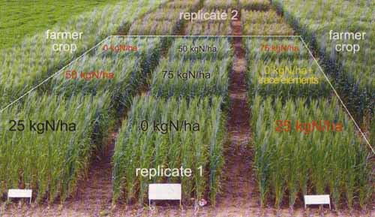
Corn!

Slide 3
Corn!
No water

Slide 4
Corn!
No water
Once a week

Slide 5
Corn!
No water
Once a week
Twice a week

Slide 6
Corn!
No water
Once a week
Twice a week
No nitrogen
25kg nitrogen
75kg nitrogen

Slide 7
The factorial design is used to study the relationship of two or more independent variables (called factors) to a dependent variable, where each factor has two or more levels. - p. 333

Slide 8
The factorial design is used to study the relationship of two or more independent variables (called factors) to a dependent variable, where each factor has two or more levels.
In this design, you can evaluate the main effects of each factor independently (essentially equivalent to doing one-way ANOVA’s for each of the factors independently), but you are also able to evaluate how the two (or more factors) interact.

Slide 9
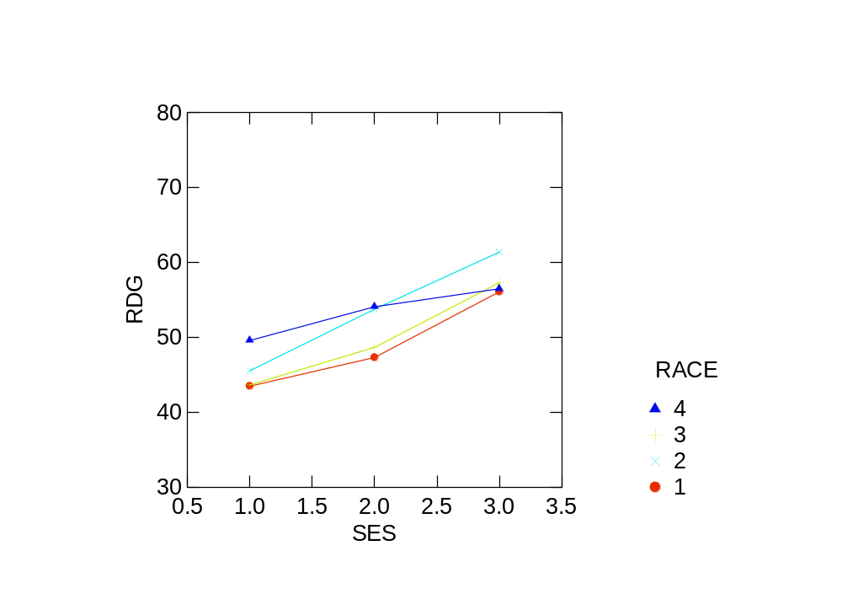

Slide 10
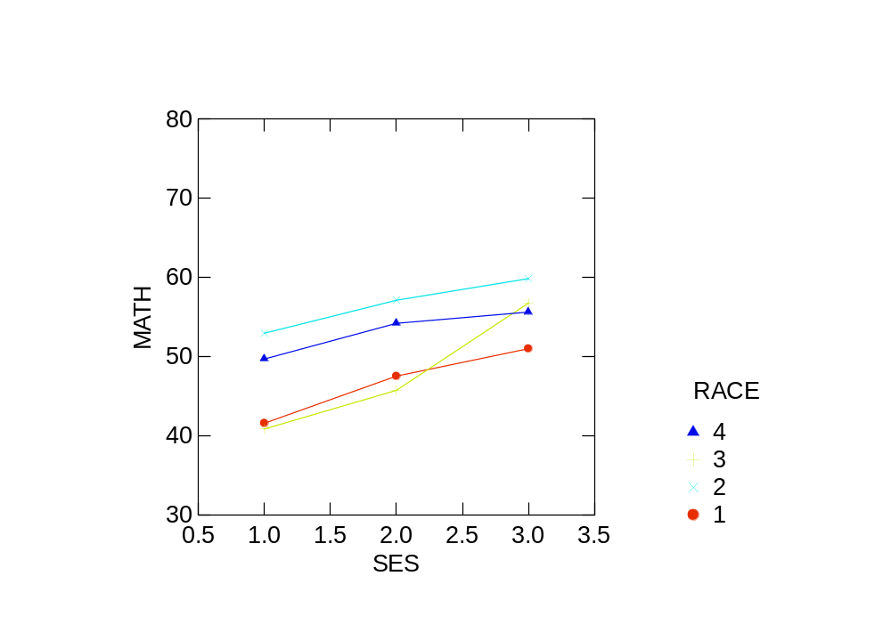

Slide 11
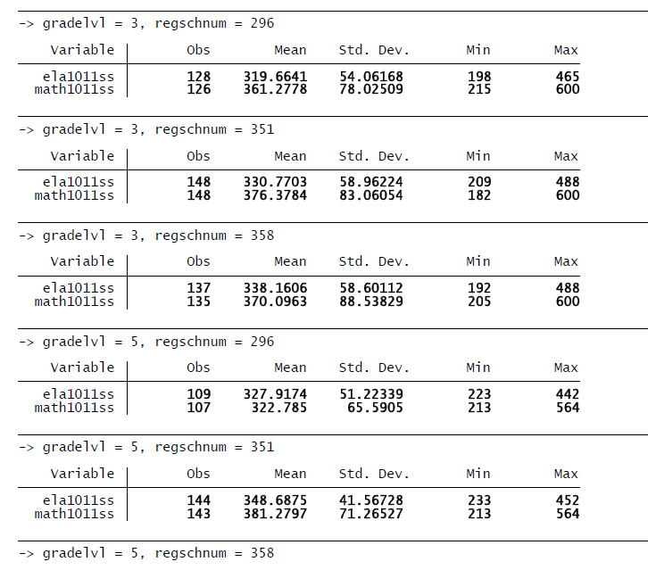


Slide 12
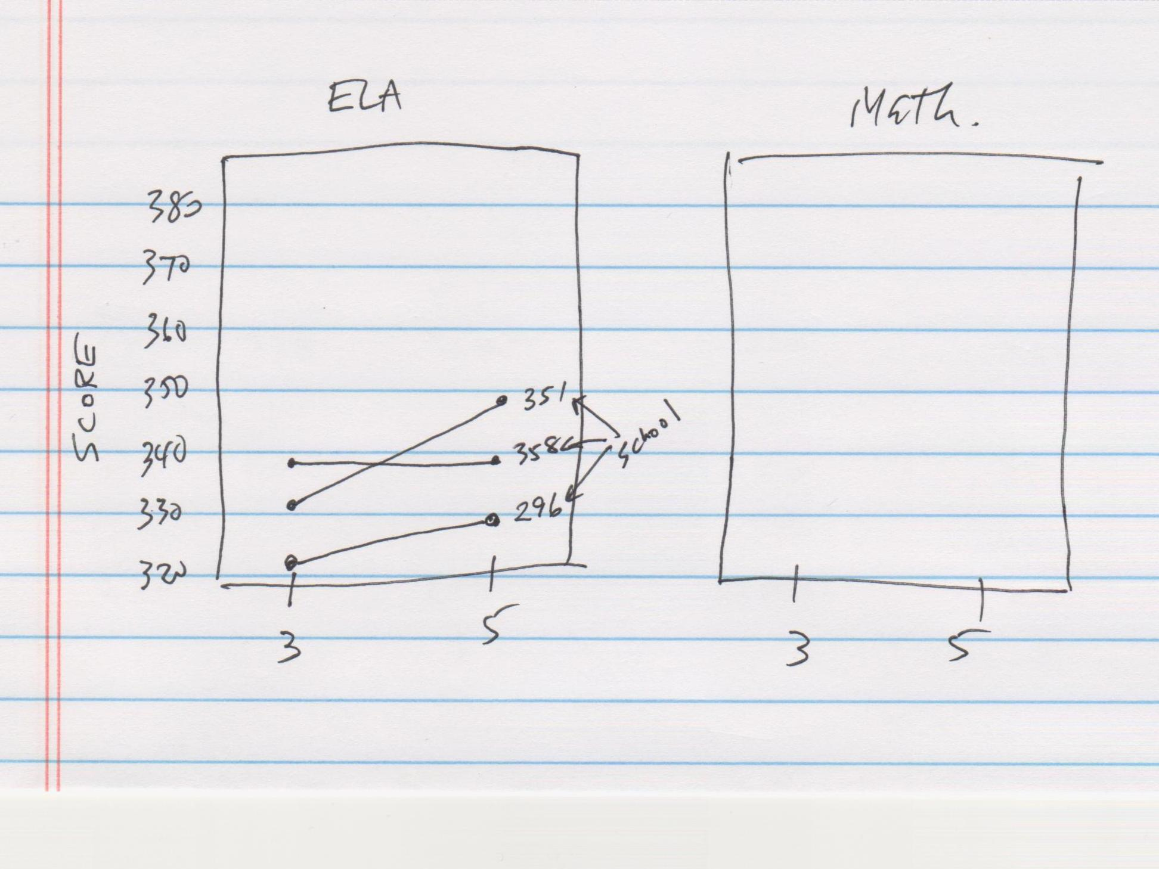

Slide 13
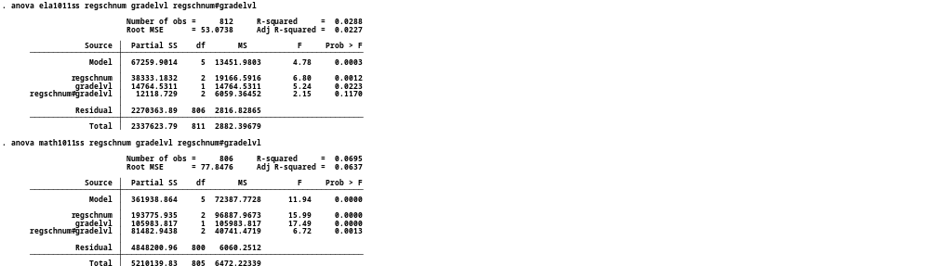

Slide 14
Partitioning variation in a 2x2 factorial design.
TOTAL VARIATION
Variation between groups
Variation within groups (error)
Variation
from Factor 1
Variation
from Factor 2
Variation from
Factor 1 x 2 interaction

Slide 15
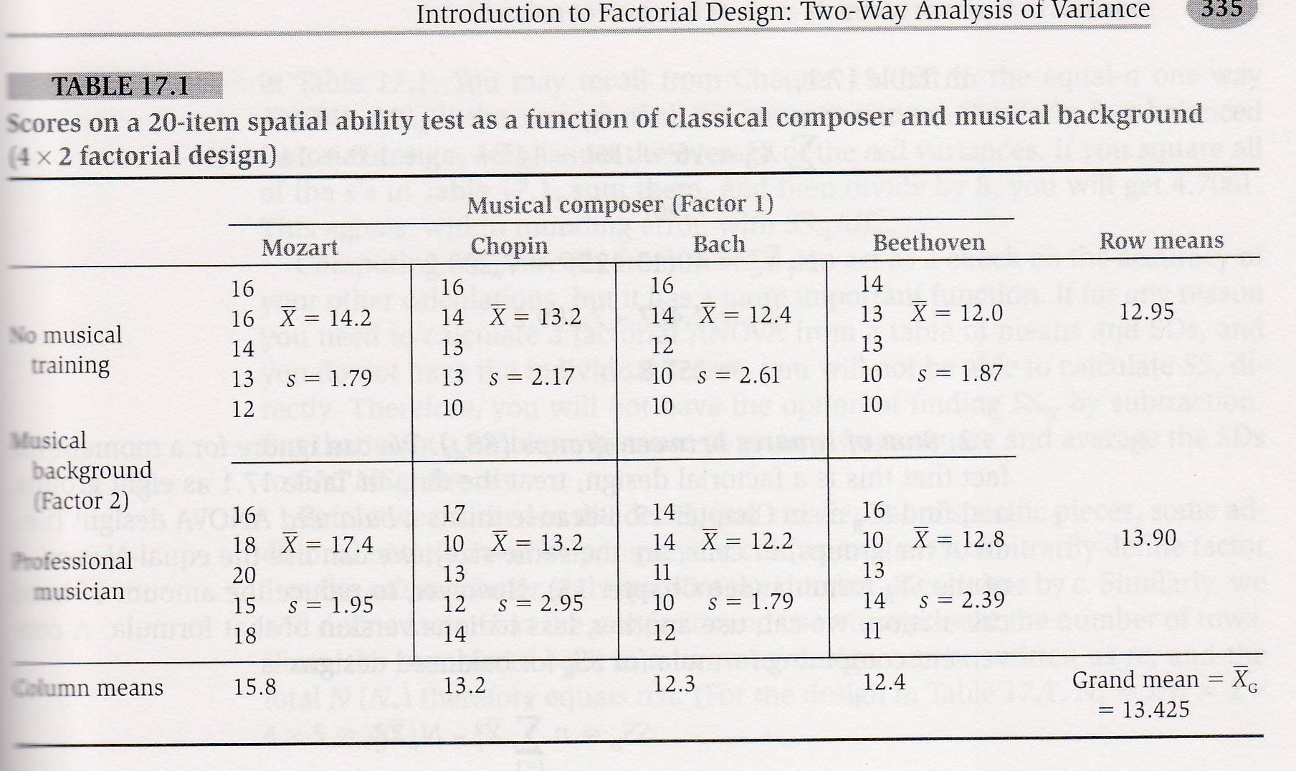

Slide 16
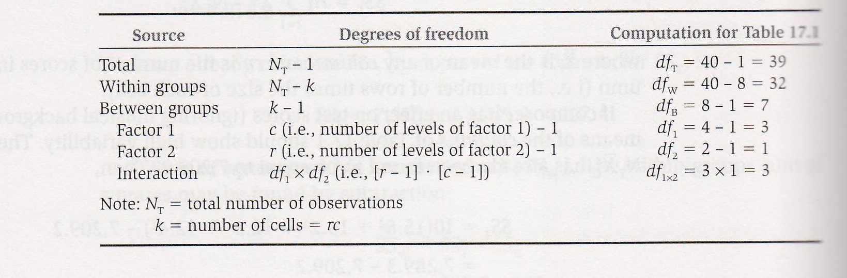

Slide 17
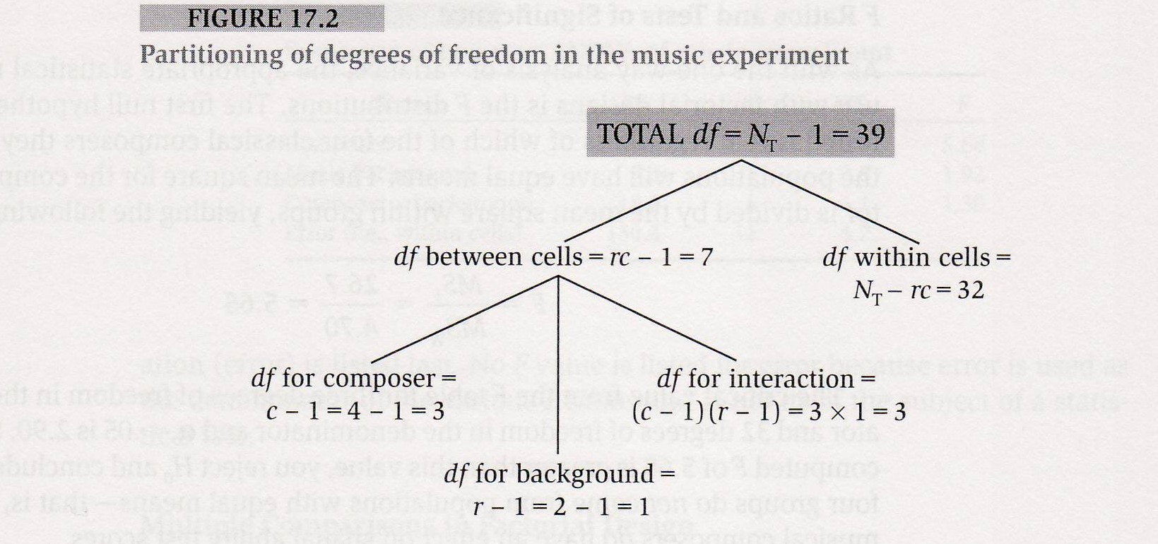

Slide 18
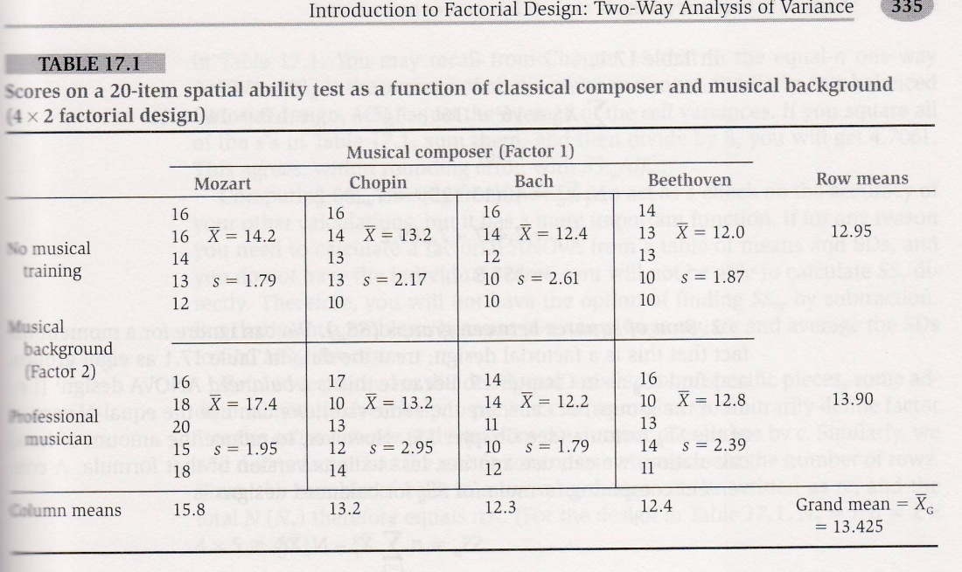
1.A Compute SS_{T}
B. Compute SS_{B}
C. Subtract SS_{B} from SS_{T} to obtain SS_{W} (error)
D. Compute SS₁
E. Compute SS₂
F. Compute SS_{1x2} by subtracting SS₁ and SS₂ from SS_{B}
2. Convert SS to MS by dividing SS by the appropriate d.f.
3. Test MS₁,MS₂ and MS_{1x2} using F ratio.

Slide 19
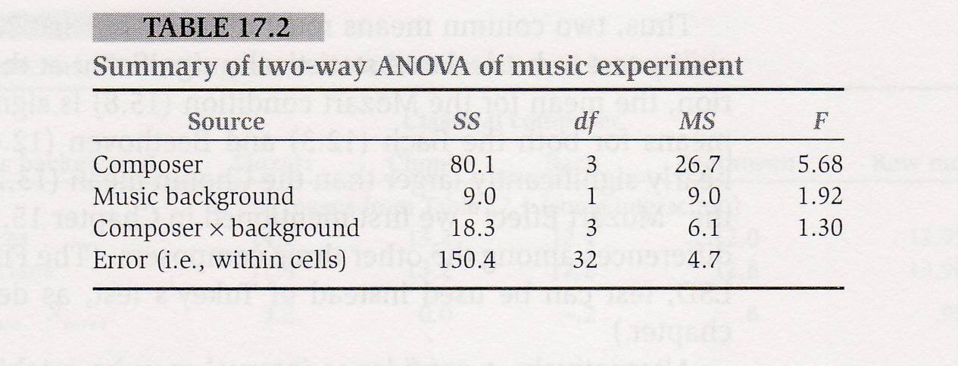

Slide 20
More advanced ANOVA topics
N-way ANOVA
Repeated Measures designs
Mixed models
Contrasts

